Slide 1
A New Approach To Extract Meaningful Clinical Information From Medical Notes
by: Awanish Ranjan & Rabindra Bista
Department of Computer Science and Engineering
Kathmandu University
Dhulikhel, Nepal
awa.ran@gmail.com, rbista@ku.edu.np
December 06, 2017

Slide 2
Outline
Introduction
Literature Review
Computational Framework
Results & Discussion
Conclusion & Future Work
Application Areas

Slide 3
Introduction
Medical Notes
“Pt presents with hyperlipidemia and strong family hx of CAD. Keeps active with job, kids, and softball, but no routine cardio exercise.”
Unstructured Data
Can’t be used as direct input for further processing
Structured Data
Regular pattern and used for further processing
Notes:
-couldn’t directly give input to comp system

Slide 4
Introduction (cont..)
Natural Language Processing techniques to solve this problem
Domain
English Language
Health care data
Medical notes text files
Extracted information
Diagnosis, Procedure, Drug, Vital and Habits

Slide 5
Objectives
Propose a new approach to extract meaningful data from clinical notes
Extract meaningful clinical information from notes
Store the information for future use
Compare the effectiveness of the proposed system with some existing system

Slide 6
Literature Review
MedEX - Xu, H. et.al [2009]
Structured data extraction
Input Clinical Text:
"acetaminophen
325- 650 mg po/pr q4 -6h prn"
Structured Output:
Drugname: acetaminophen
Strength: 325-650 mg, Route: pc/pr
Frequency: q4 -6h
Necessity: pm
Limited to Drug Data only

Slide 7
Literature Review (cont..)
Other relevant systems
cTAKES - Sovava, K.G. et. al [2010]
YTEX - Glara, V. et. al. [2011]
MetaMap ⁻ Aronson, et. al. [2001]
MEDLEE - Friedman et. al [1994]
Problems with existing system
Less Accuracy
Too specific
Lot of third party dependencies
Notes:
cTAKES ^{[2]}
Mayo clinical Text Analysis and Knowledge Extraction System
Sovava, K.G. et. al (2010) at MayoClinic
OpenNLP, UIMA
Less Accuracy
YTEX ^{[3]}
Yale cTAKES Extension
Glara, V. et. al. (2011)
Hepatic Decompensation data extraction
Limited scope
MetaMap ^{[4]}
Aronson, et. al. (2001)
Mapping biomedical records to UMLS
Used for extracting patient’s medical problem
Dependent on third party tool UMLS
MEDLEE ^{[5]}
Medcial Language Extraction and Encoding system
Friedman et. al (1994)
Radiology notes
Limited scope

Slide 8
Computational Framework

Slide 9
Computational Framework (cont..)
Input - Medical notes, text files
1. Sentence Detector- [“FBS & hgA1c both slightly improved, but still prediabetes (HgA1c = 5.8%).”, “But did instruct on diet/exercise.”]
2. Preprocessing
Abbreviation handling: dx -> diagnosis
Punctuation handling: don’t” -> do not
Lower case conversion
ASCII character removal
Notes:
E.g. pt is expanded as patient; dx is expanded as diagnosis etc

Slide 10
Computational Framework (cont..)
3. Tokenizer: 'FBS', '&' , 'hgA1c', 'both’
4. Parts-Of-Speech (POS) Tagging:
('FBS', 'NNS') ('&', 'CC') ('hgA1c', 'NNP') ('both', 'DT') ('slightly', 'RB') ('improved', 'VBN')
5. Noun-Verb (NN-VB) Extractor
Noun phrases - NN, NNS, NNP, NNPS
Verb phrases - VB, VBD, VBG, VBN, VBP, VBZ

Slide 11
Computational Framework (cont..)
6. Named Entity Recognition
Detection of elements – Diagnosis, Procedure, Drug, Vital, Habit
Medical corpus building, training and matching
Notes:
Entity Type
Description
Example
Diagnosis
Disease associated with the patient
Diabetes, hypertension, cancer etc.
Procedure
Any procedure done for identification or cure of the disease
MRI, CT Scan, Lab Tests, Therapies etc.
Drug
Medications taken by the patient
Metformin, Lantus, Insulin etc.
Habits
Different habits related to health
Exercise, smoking, jogging etc.
Vitals
Vital signs associated with patient
Weight, height, blood sugar etc.

Slide 12
Medical Corpus
6.1 Medical corpus
Training Data Collection
15000 medical notes as training data
Health care data
Notes:
-> Readily available

Slide 13
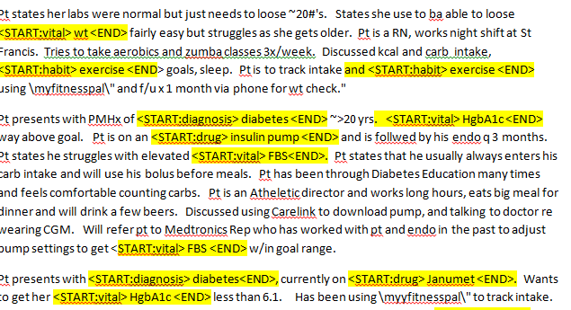
Medical Corpus (cont..)
Manual Annotation

Slide 14
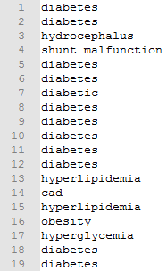
Medical Corpus (cont..)
Corpus File Generation
Different files for different corpus
Redundancy Handling
Redundant information
Notes:
-> Readily available

Slide 15
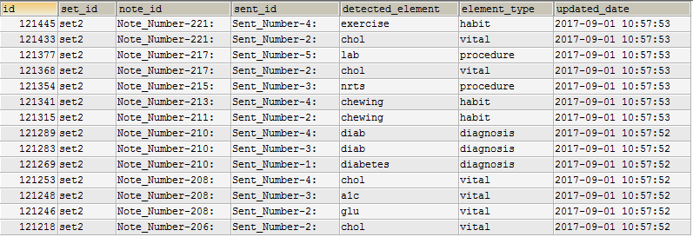
Entity Detection

Slide 16
Additional Components
6.2 Negation Handling
Negative words, no, none, free etc
6.3 Bigram Analysis
Bigram Generation
Bigram Detection
6.4 Stemming
Porter Stemmer
Stemmed Corpus file
Stemmed NER

Slide 17
Results & Discussions
Types of Test Results
 |  | Condition
 |  | Present | Absent
Test | Positive | True Positive (TP) | False Positive (FP)
 | Negative | False Negative (FN) | True Negative (TN)

Slide 18
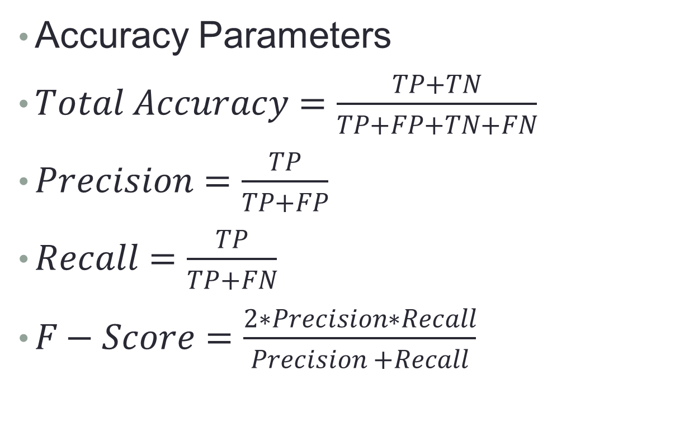
Results & Discussions (cont..)
Accuracy Parameters
$Total Accuracy=\frac{TP+TN}{TP+FP+TN+FN}$
$Precision=\frac{TP}{TP+FP}$
$Recall=\frac{TP}{TP+FN}$
$F−Score=\frac{2∗Precision∗Recall}{Precision +Recall}$
Notes:
Total Accuracy: This parameter denotes the ratio of correctly categorized elements to the total elements.
Precision: It answers the question: out of all positively classified elements, how many are correct?
Recall: It answers the question: out of all actually positive elements present, how many were we able to classify as positive?
F-Score: This is the harmonic mean of precision and recall. It takes both false positives and false negatives into account. F-Score value is more valuable since we can get the feel of both precision and recall through same value.

Slide 19
Results – Varying Corpus Size (cont..)
Accuracy Vs. Training Data Size
Notes:
More sentences, better coverage
Initial increment from 1000 to 5000 is sharp since uniqueness gets decreased
Accuracy parameters increases
Execution time increases
We take 15000 corpus for the rest of the analysis

Slide 20
Results – Varying Test Data
4 different test set
Notes:
5% test set
10% test set
15% test set
20% test set
15000 sentenced corpus

Slide 21
Results – Comparison with MedEX
Notes:
Accuracy is high due to
Use of negation
Specific drug name vs. Medicine with disease name e.g. bp meds

Slide 22
Conclusion
Able to extract meaningful information
Results saved in database
Accuracy improved
Contribution to the knowledge
Medical Corpus 15000+ notes.
Integrating the techniques of negation handling, bigram analysis and stemming in same system
More generalization
Improved accuracy

Slide 23
Future Works
Corpus size can be increased
Can be extended to detect other medical information and further parts of speech
To build a learning system which will allow to add more undetected true positive elements in corpus
Can be extended to work on speech and visual data
Trigram & further n-gram analysis
Other accuracy parameters like Specificity

Slide 24
Application Areas
Extracting information from
Family history
Discharge summary
Automatic reporting
Developing standards
Machine learning
Prediction systems
Suggestion systems

Slide 25
References
Xu, H.; Stenner, S.P.; Doan,S.;Johnson, K.B.; Waitman,L.R.;Denny, J.C. (2009, October 21). MedEx: a medication information extraction system for clinical narratives. Journal of the American Medical Informatics Association (JAMIA) pp. 19-24
Savova G.K,; Masanz,J.J.; Ogren, V.P.; Zheng, J.; Sohn, S.; Kipper-Schuler, C.K.;Chute, G.C. (2010, June 29). Mayo clinical Text Analysis and Knowledge Extraction System (cTAKES): architecture, component evaluation and applications. Journal of the American Medical Informatics Association (JAMIA) pp. 507-513.
Garla, V.; Re, L.V. III; Dorey-Stein, Z.; Kidwai, F.; Scotch, M.; Womack,J.; Justice,A.; Brandt,C. (2011, April 22). The Yale cTAKES extensions for document classification: architecture and application. Journal of the American Medical Informatics Association (JAMIA) pp. 1-7
Aronson, A.R. (2001). Effective Mapping of Biomedical Text to the UMLS Metathesaurus: The MetaMap Program. AMIA
Friedman, C.; Alderson P.O.; Austin J.H.M.; Cimino J.J.; Johnson S.B. (1994, April). A General Natural-Language Test Processing for Clinical Radiology. Journal of the American Medical Informatics Association, Volume 1 Number 2.

Slide 26
Queries ??

Slide 27
Thank You !!

